Slide 1
Python for beginners

Slide 2
Content
1. Introduction to Python
What is Python?
Installing Python & Setting up the Environment
Installing Visual Studio Code
Running Python Scripts
2. Variables and Data Types
Understanding Variables
Data Types: Integers, Floats, Strings, Booleans
Type Conversion

Slide 3
Content
3. Naming Conventions
Best Practices for Naming Variables
PEP 8 Naming Conventions
4. Operators and Expressions
Arithmetic Operators (+, -, *, /, %, //, **)
Assignment vs Comparison Operators
Logical Operators (and, or, not)
Membership Operators (in, not in)
Identity Operators (is, is not)

Slide 4
Content
5. Control Flow
Conditional Statements: if, elif, else
Loops: for loop, while loop
Loop Control Statements (break, continue, pass)
6. Lists: Creation, Indexing, Slicing, Methods
7.Dictionaries: Key-Value Pairs, Methods
8.Strings: String Methods, Formatting
9.Sets: Properties and Operations

Slide 5
Content
10. Functions and Modules
Defining Functions
Function Arguments and Return Values
Lambda Functions
Importing Modules and Using Standard Libraries
Creating and Using Custom Modules
11. Error Handling
Understanding Errors and Exceptions
Using try-except Blocks
Handling Multiple Exceptions

Slide 6
Content
12. Pandas
Installing and Importing Pandas
DataFrames and Series
Data Cleaning
Data Manipulation
Data Aggregations

Slide 7
1. Introduction to Python
What is Python?
高级解释型编程语言 / High-level interpreted programming language
应用领域：Web开发、数据分析、AI等 / Applications: Web, Data Science, AI etc.
# 官方下载 / Official download
https://www.python.org/downloads/

Slide 8
1. Introduction to Python
Installing Python & Setting up the Environment
We use python 3.11 for our course. Please go go this link to download python
https://www.python.org/downloads/release/python-3110/

Slide 9
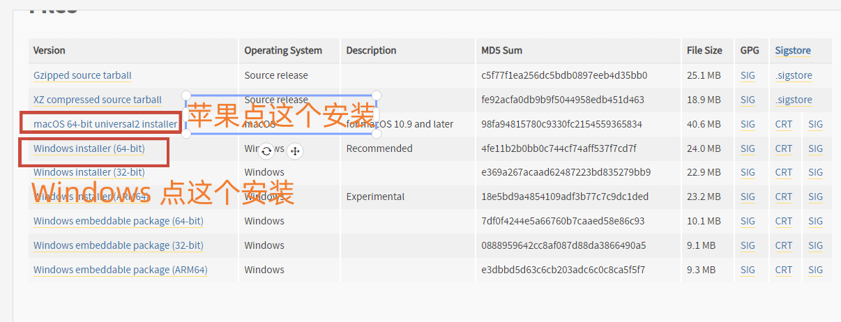
1. Introduction to Python
Installing Python & Setting up the Environment

Slide 10
1. Introduction to Python
Installing Python & Setting up the Environment

Slide 11
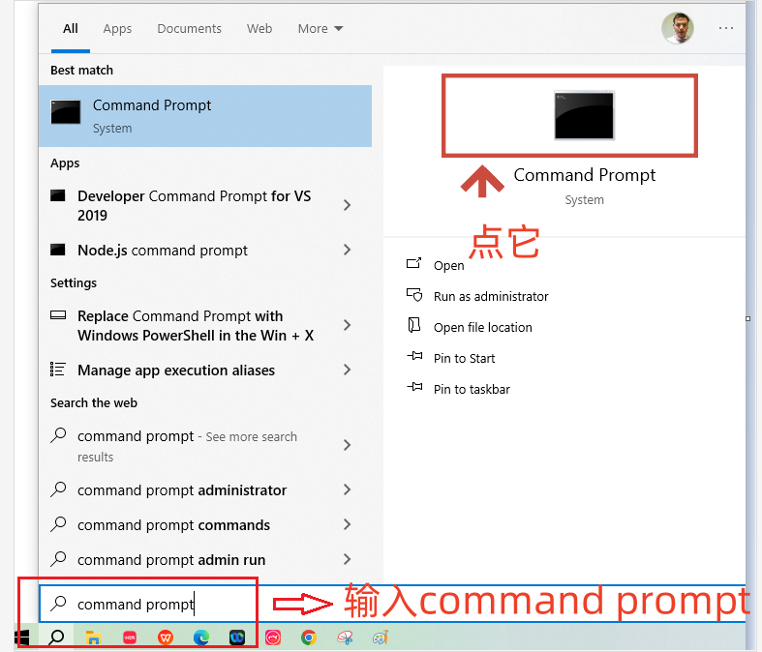
1. Introduction to Python
Installing Python & Setting up the Environment
Open command line from start menu on Windows

Slide 12
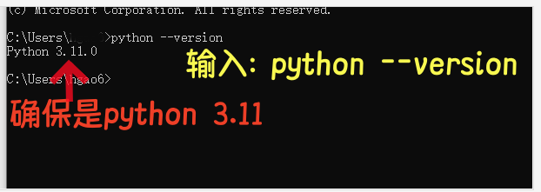
1. Introduction to Python
Installing Python & Setting up the Environment
Verify installed python version is 3.11

Slide 13
1. Introduction to Python
Installing Visual studio code
Visual studio code(VS Code): is a popular free code editor used in industry. We’ll use it in our course
Go to Link below to download visual studio code
https://code.visualstudio.com/download

Slide 14
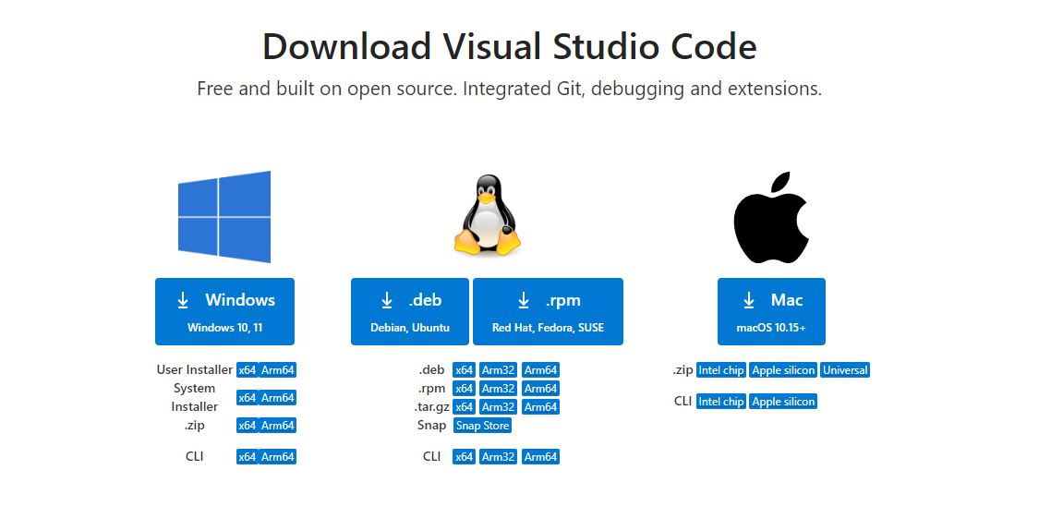
1. Introduction to Python
Installing Visual studio code

Slide 15
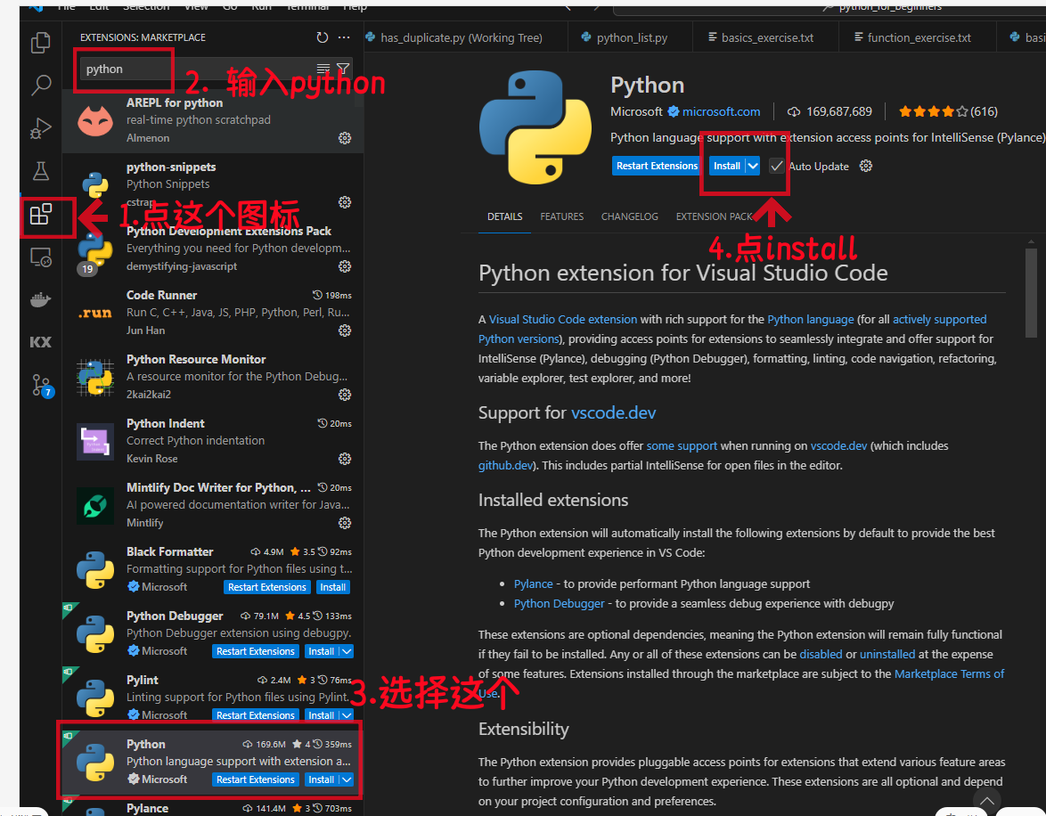
1. Introduction to Python
Set up Visual studio code(install python extension)

Slide 16
1. Introduction to Python
Running python script
1. Create a new python script and run it
2. Open existing python script and run it

Slide 17
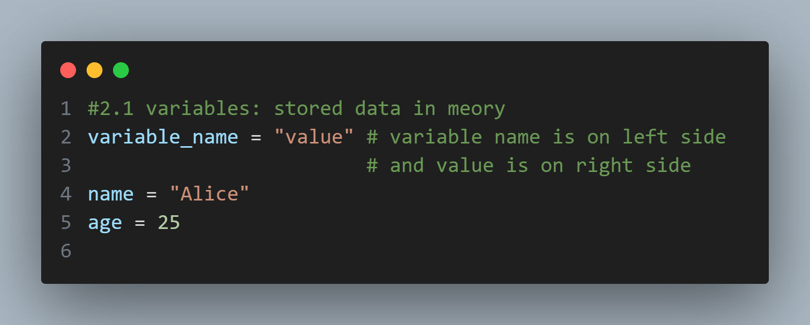
2. Variables and Data Types
Variables store data in memory.

Slide 18
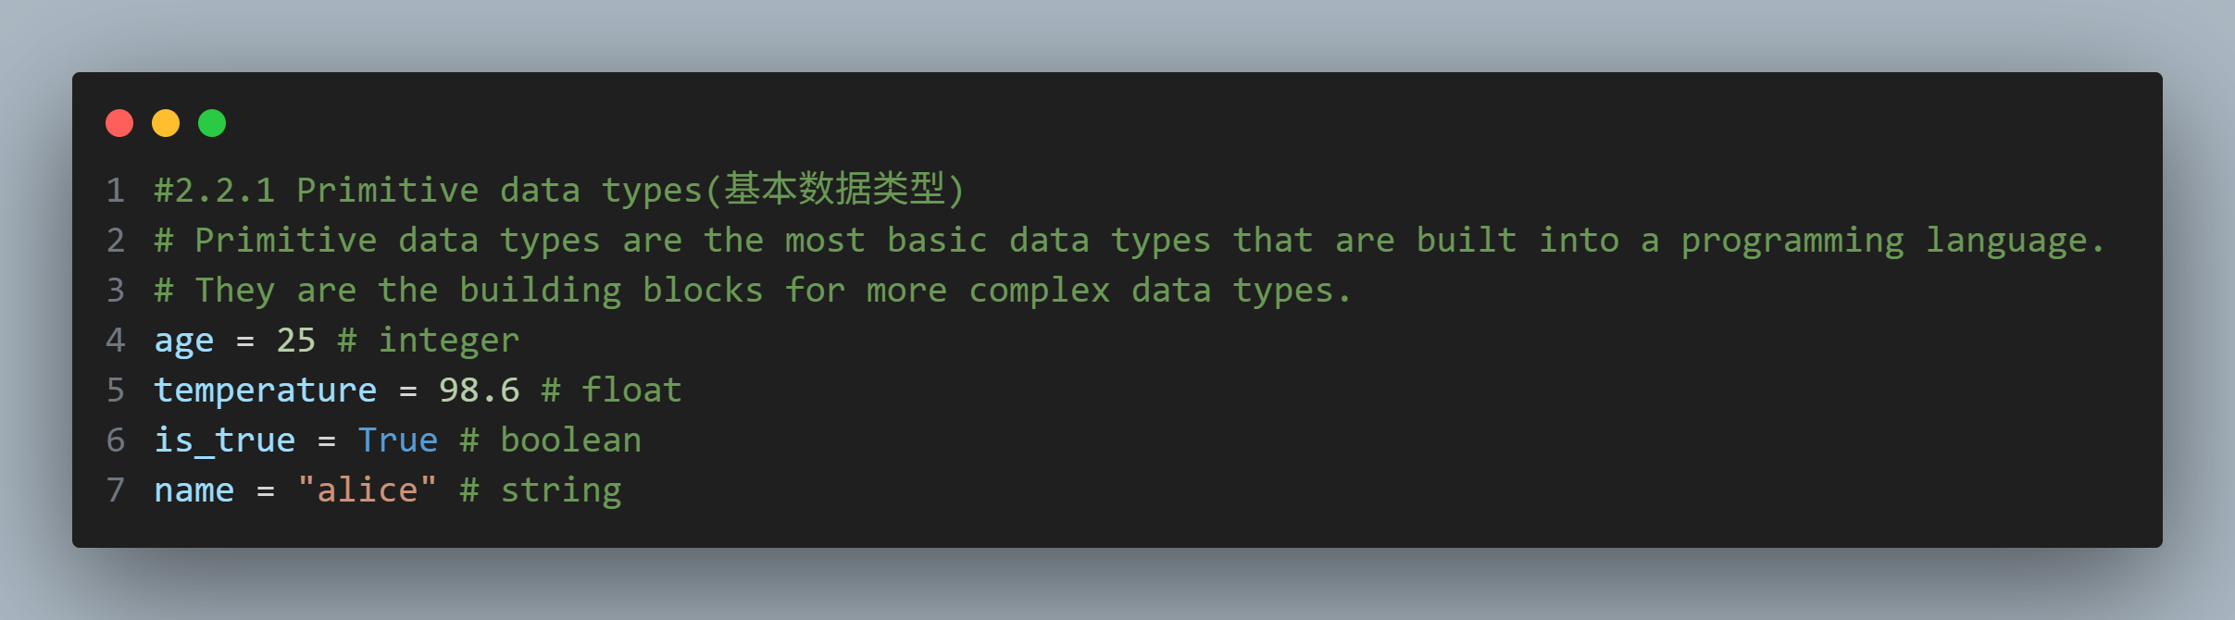
2. Variables and Data Types
Primtive data types(基本数据类型)

Slide 19
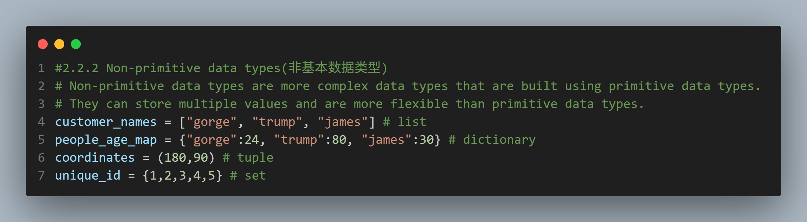
2. Variables and Data Types
Non Primtive data types(非基本数据类型)

Slide 20
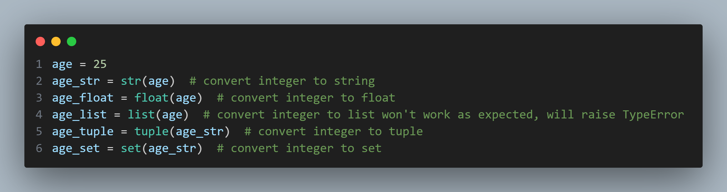
2. Variables and Data Types
Data type conversion：is the process of converting one data type to another

Slide 21
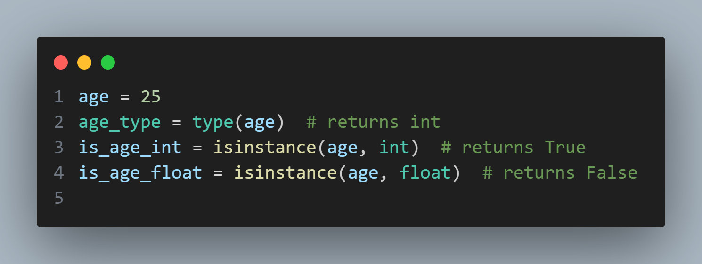
2. Variables and Data Types
Type checking: checking the data type of a value

Slide 22
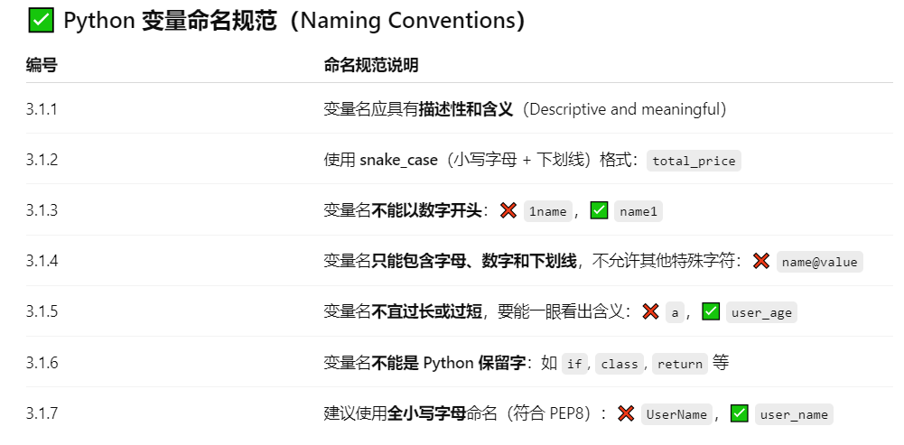
3. Naming Conventions

Slide 23
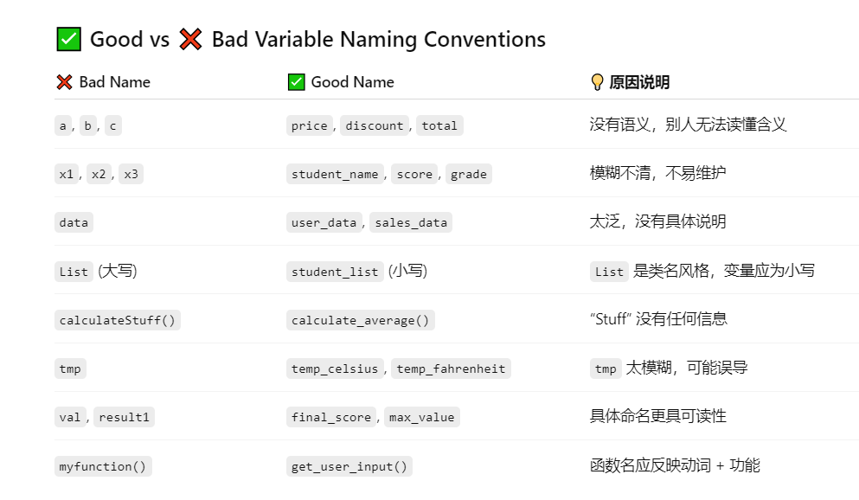
3. Naming Conventions
Bad vs Good variable names

Slide 24
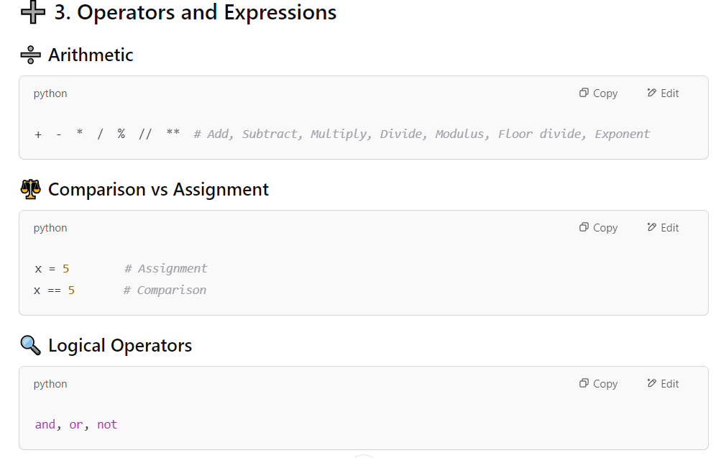
4. Operators and Expressions

Slide 25
4. Operators and Expressions
Comparison vs Assignment (Very easily confused two topics, common bug in real world project and coding interview !!)
Assignment: restaurant_name = “KFC” # doesn’t return anything
Comparison: restaurant_name == “KFC” # return True or False

Slide 26
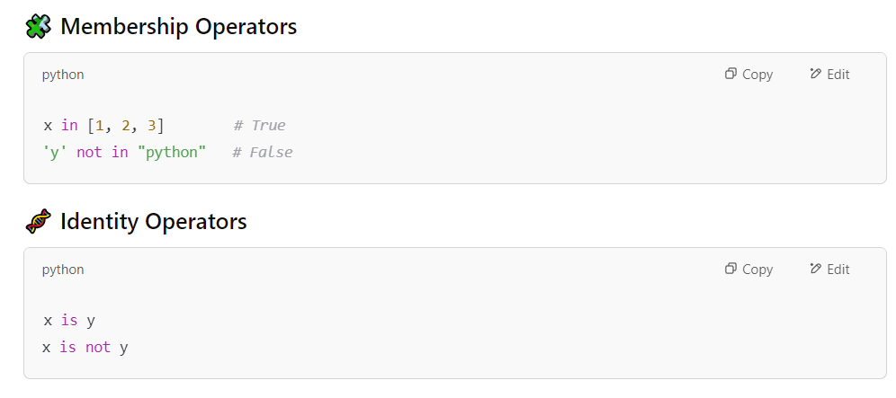
4. Operators and Expressions
Membership operators: to check if a value is present in a sequence (list, tuple, string, etc.). Return True or False
Identity operators: compare the memory location of two objects. Return True or Flase

Slide 27
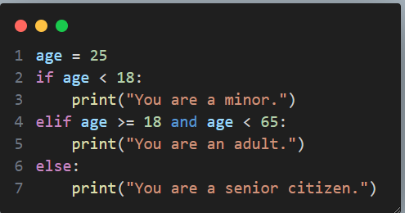
5. Control Flow
if elif else
If the condition is true, the code block inside the if statement is executed
else statement is executed if all the conditions are false

Slide 28
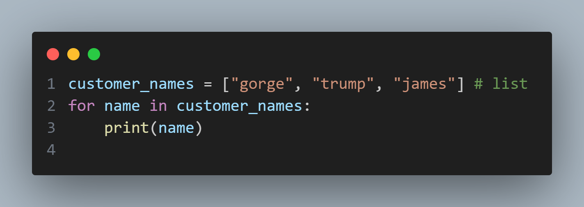
5. Control Flow
for loop
for loop is used to iterate over a sequence (list, tuple, dictionary, set, or string)

Slide 29
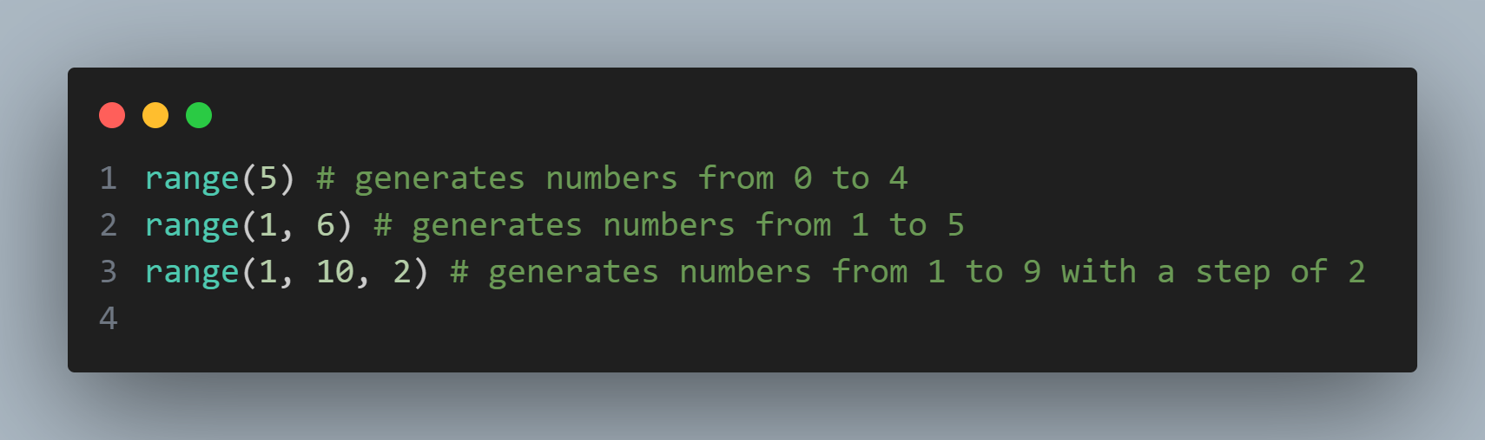
5. Control Flow
range function:
The range function is used to generate a sequence of numbers

Slide 30
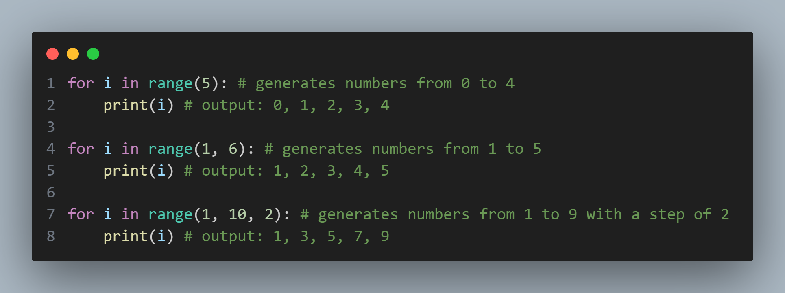
5. Control Flow
range function:
The range function is used to generate a sequence of numbers

Slide 31
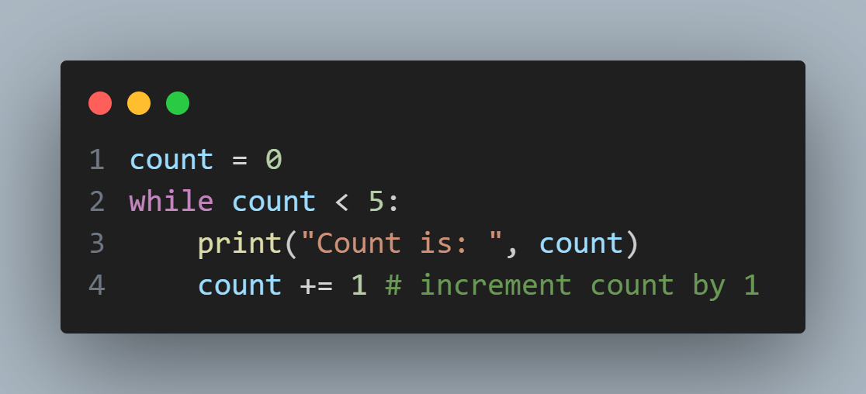
5. Control Flow
while loop
The while loop is used to execute a block of code as long as a condition is true

Slide 32
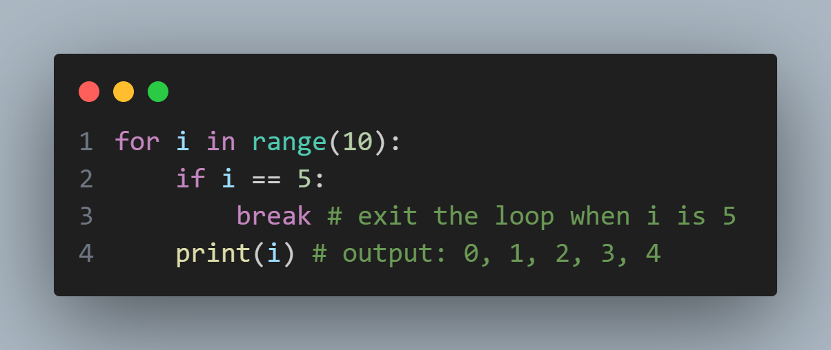
5. Control Flow
break statement
The break statement is used to exit a loop prematurely

Slide 33
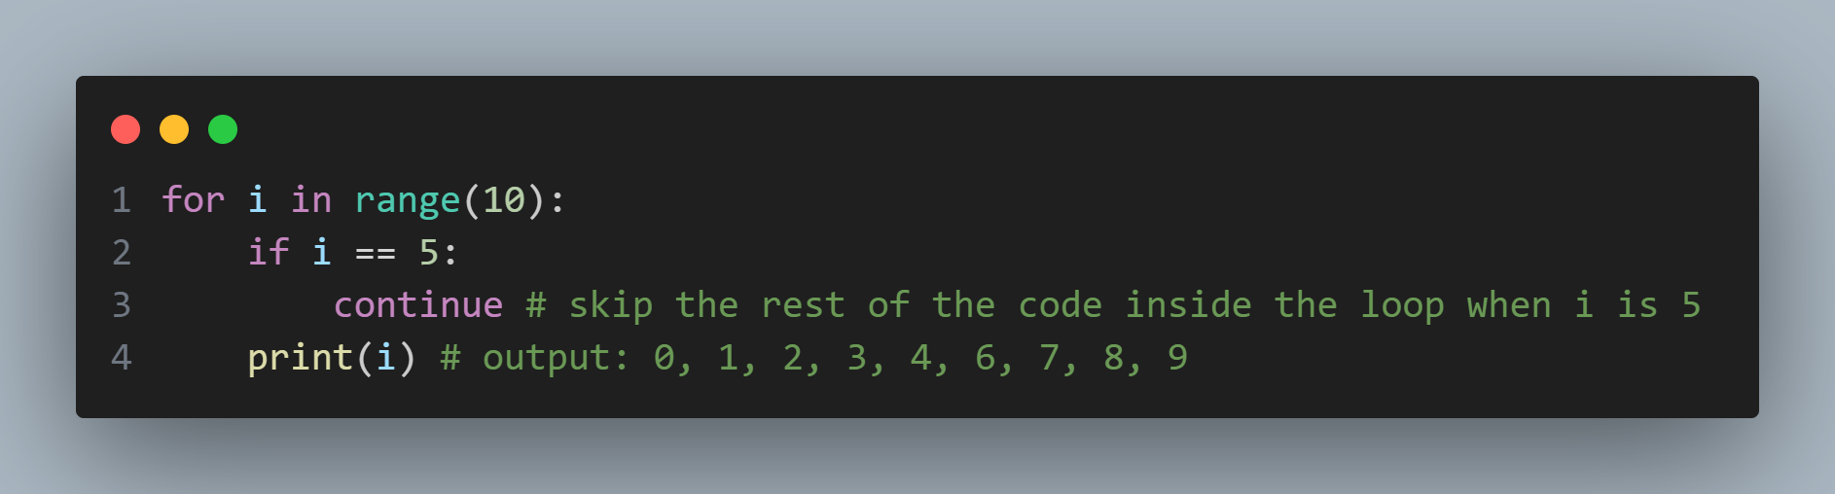
5. Control Flow
continue statement
The continue statement is used to skip the current iteration of a loop

Slide 34
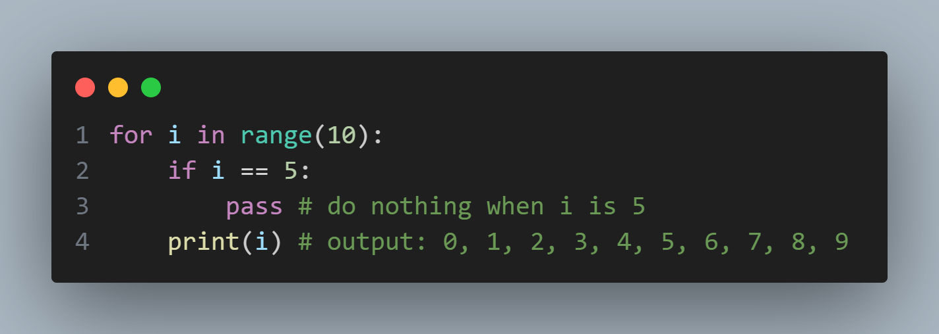
5. Control Flow
pass statement
The pass statement is used as a placeholder for future code

Slide 35
5. Exercises
5.1 Print even numbers from 1 to 20
5.2 Print numbers from 1 to 10, but skip the number 5
5.3 Print numbers from 1 to 10, but stop the loop when the number is 7
5.4 keep printing numbers as long as the number is less than 10

Slide 36
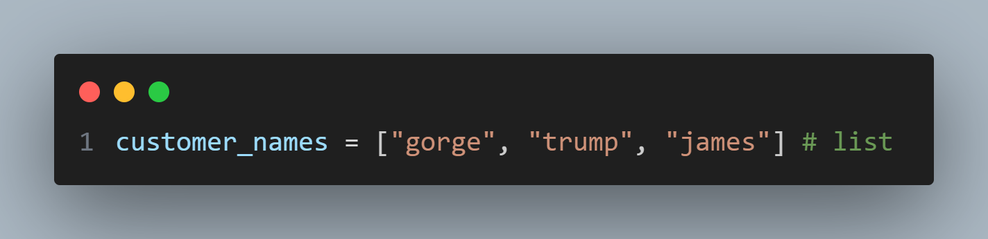
6. List
A list is a collection of items that are ordered and changeable.

Slide 37
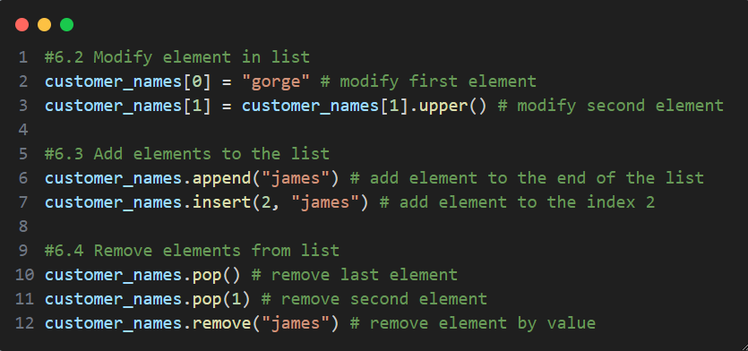
6. List
Common list operations
modify element
add element
remove element

Slide 38
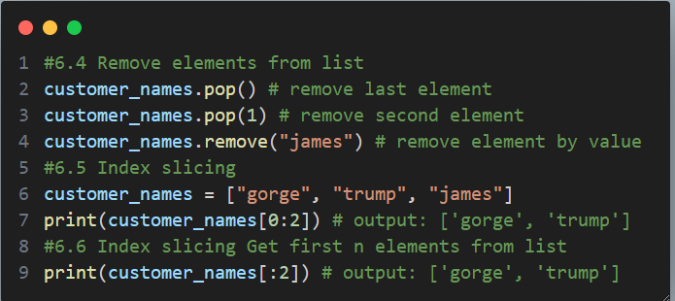
6. List
Common list operations
pop
remove
index slicing

Slide 39
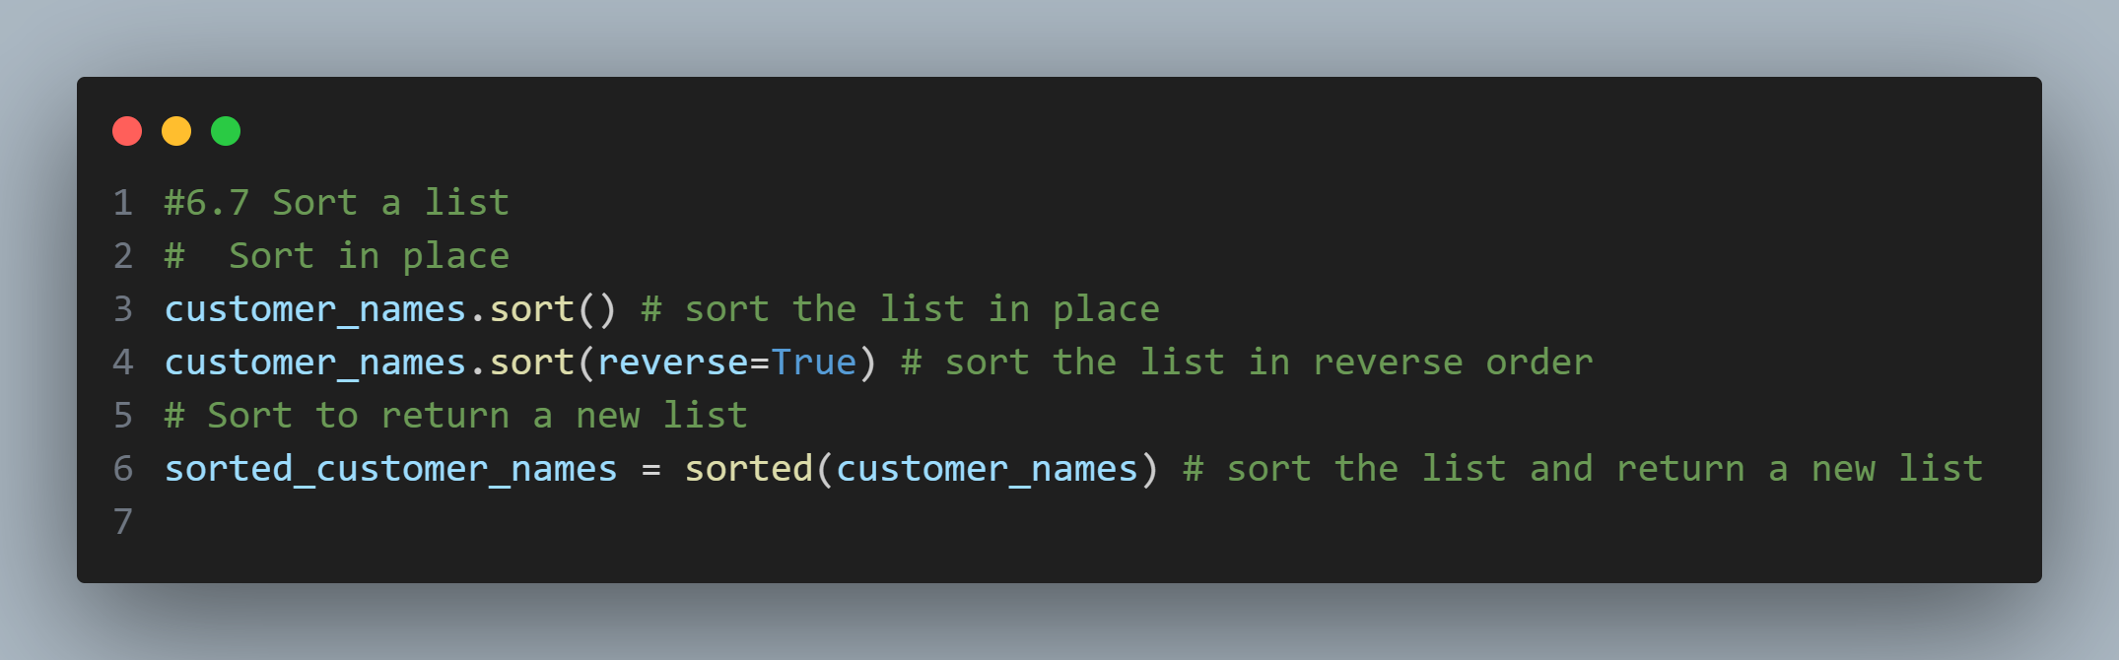
6. List
Common list operations
Sort

Slide 40
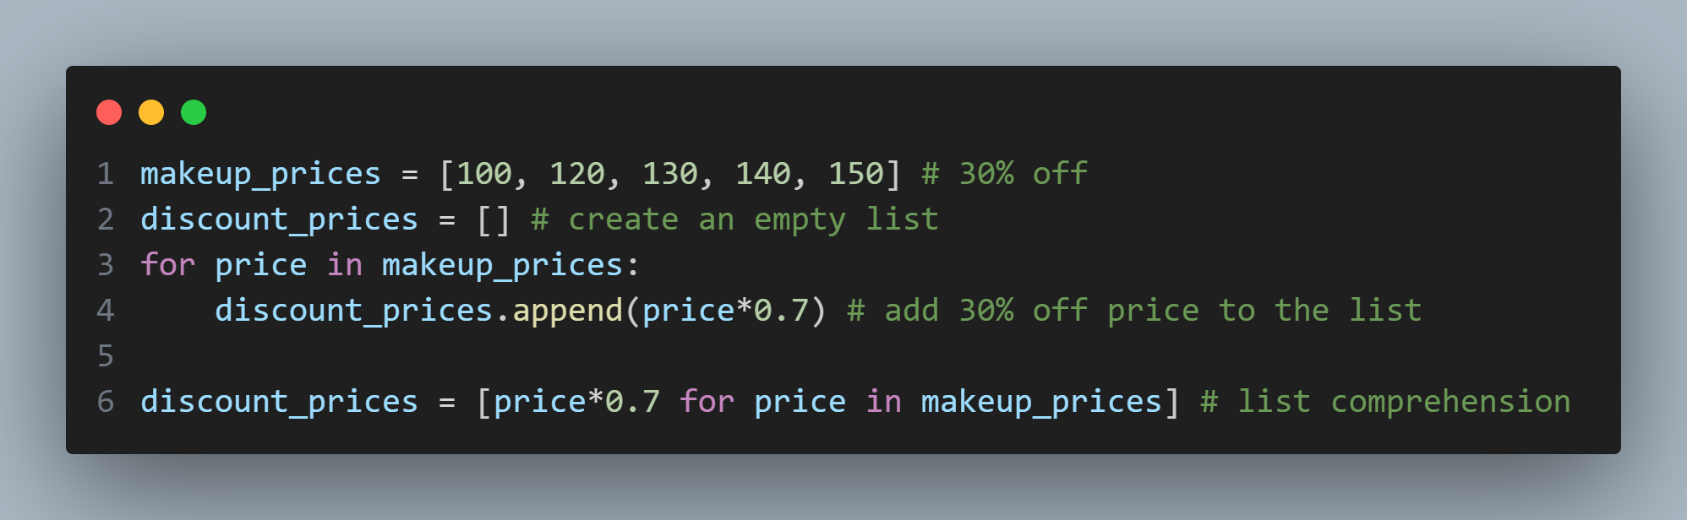
6. List
List comprehension(Common interviw question!)
List comprehension is a concise way to create lists

Slide 41
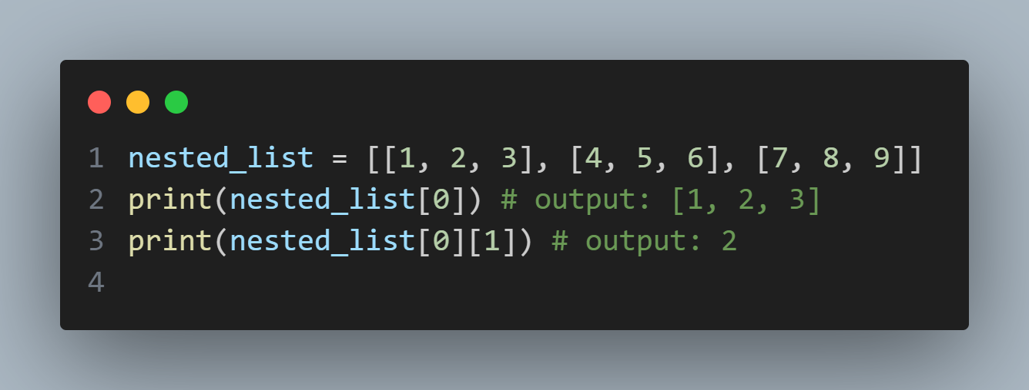
6. List
Nested list
A nested list is a list that contains other lists

Slide 42
6. List
Exercises
Refer to python file in list_exericse folder

Slide 43
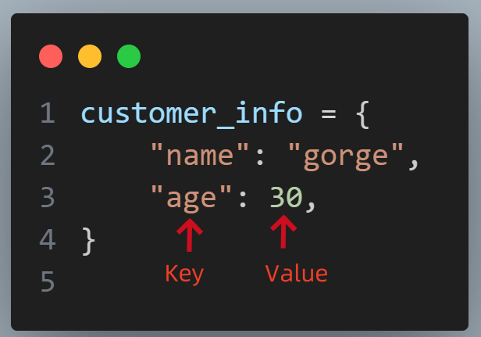
7. Dictionary(Very important data type!)
A dictionary is a collection of key-value pairs

Slide 44
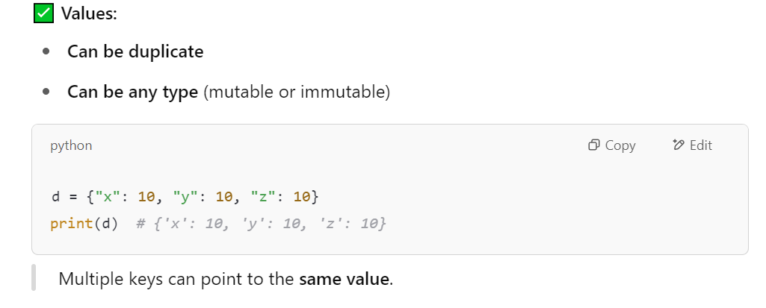
7. Dictionary(Very important data type!)
A dictionary cannot have duplicate key but can have duplicate values( very important property)

Slide 45
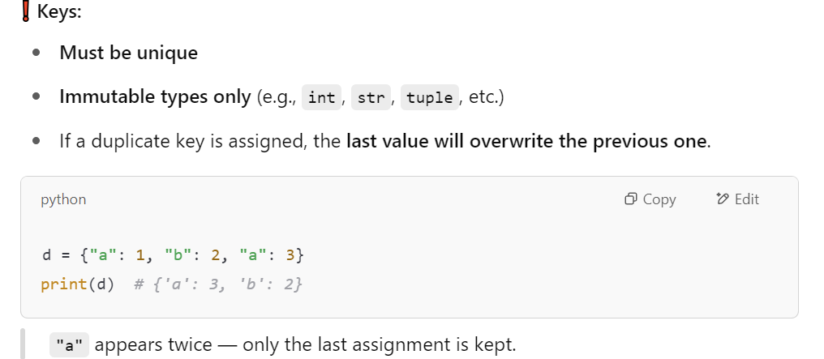
7. Dictionary(Very important data type!)
A dictionary cannot have duplicate key but can have duplicate values( very important property)

Slide 46
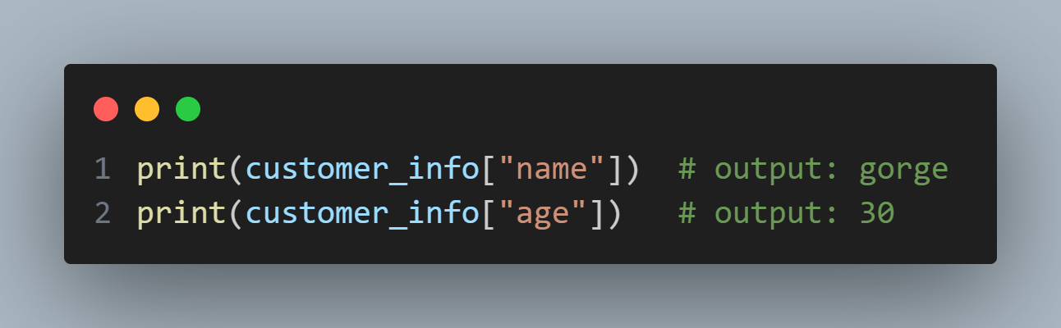
7. Dictionary(Very important data type!)
Access values

Slide 47
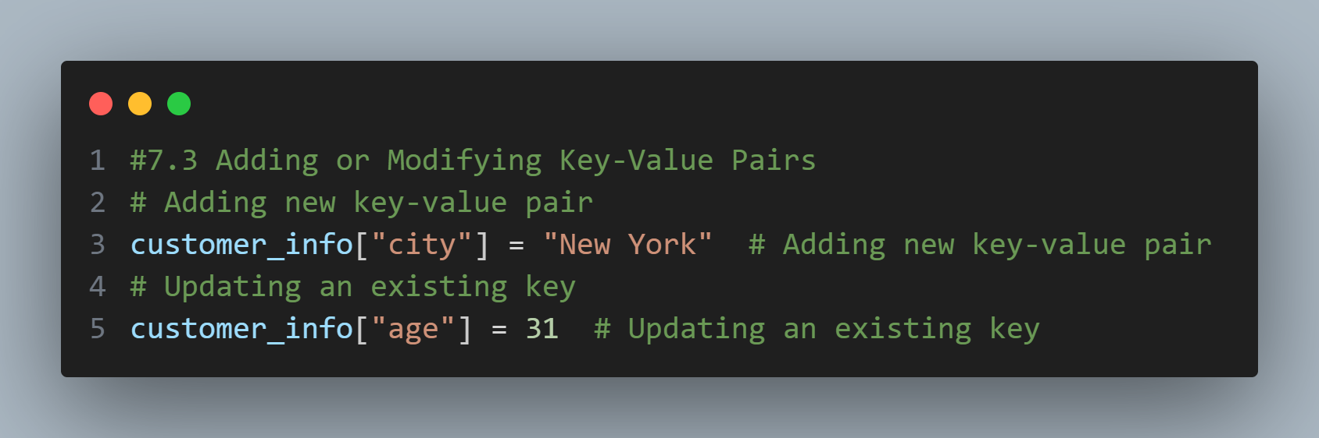
7. Dictionary(Very important data type!)
Add or modify key-value pairs

Slide 48
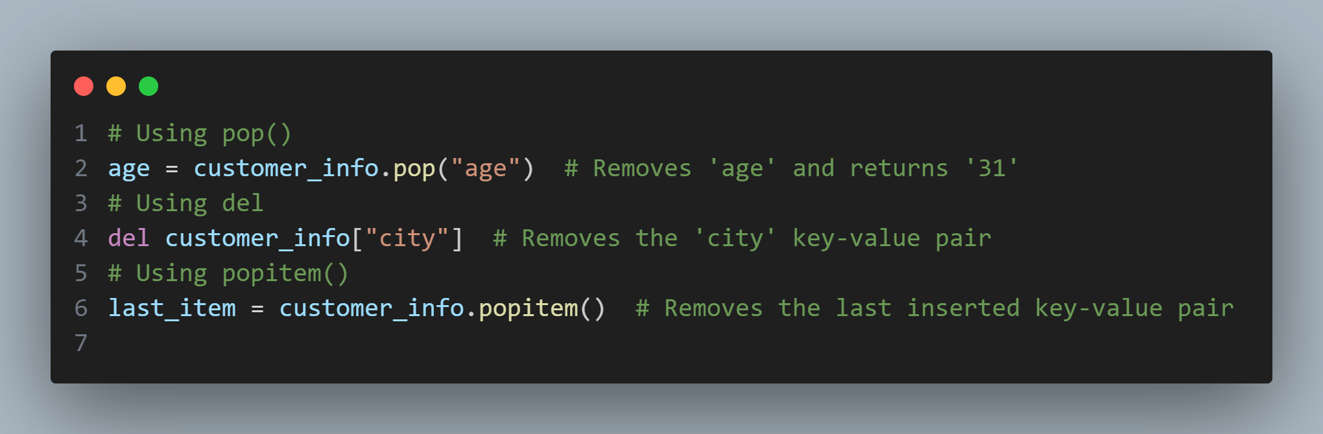
7. Dictionary(Very important data type!)
Remove key-value pairs

Slide 49
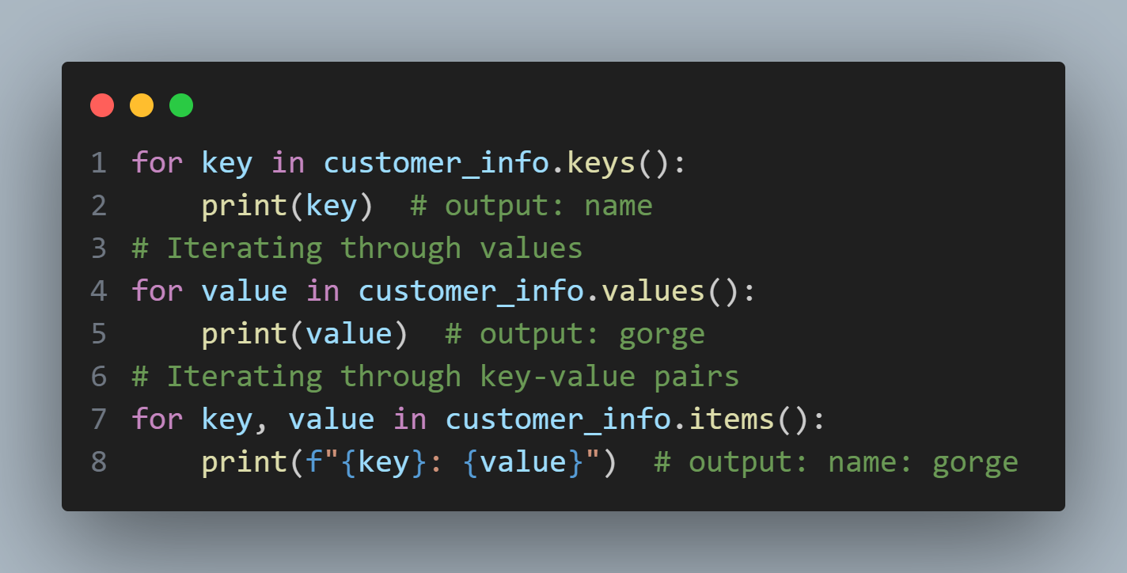
7. Dictionary(Very important data type!)
Looping all key-value pairs in a dictionary

Slide 50
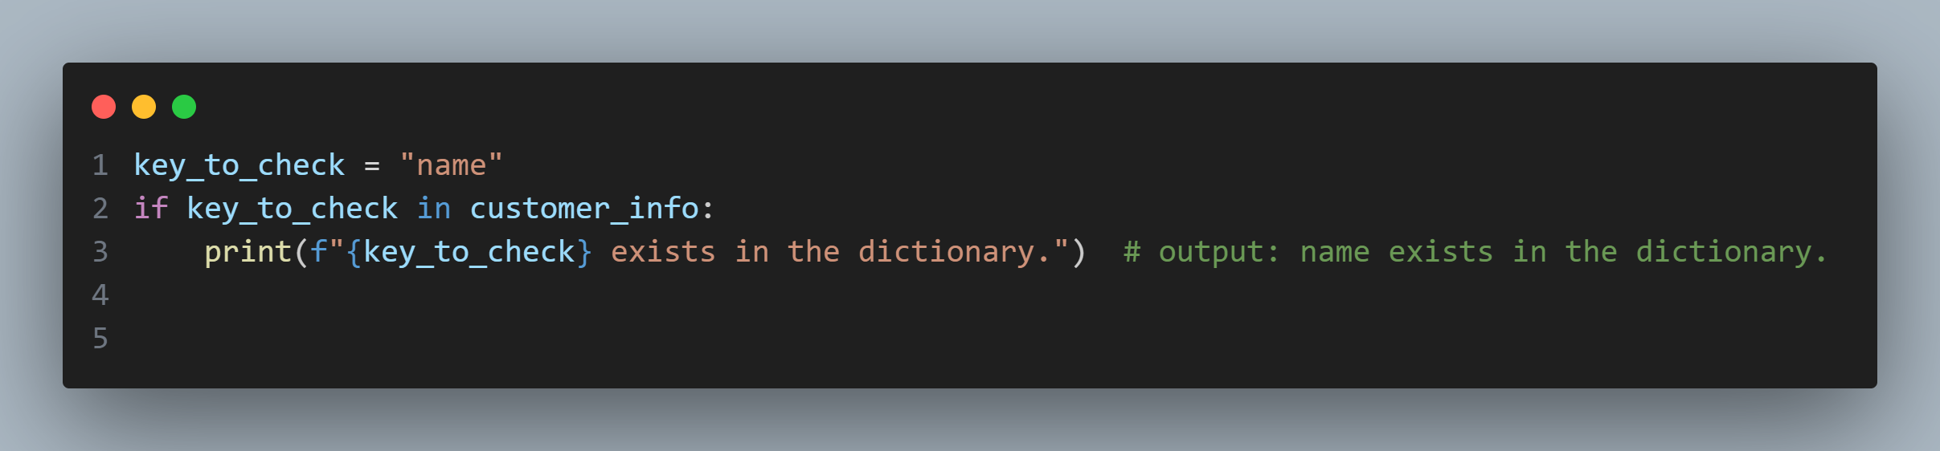
7. Dictionary(Very important data type!)
Check if a key exist in dictionary

Slide 51
7. Dictionary(Very important data type!)
Exercise:refer to dictionary_exercise folder

Slide 52
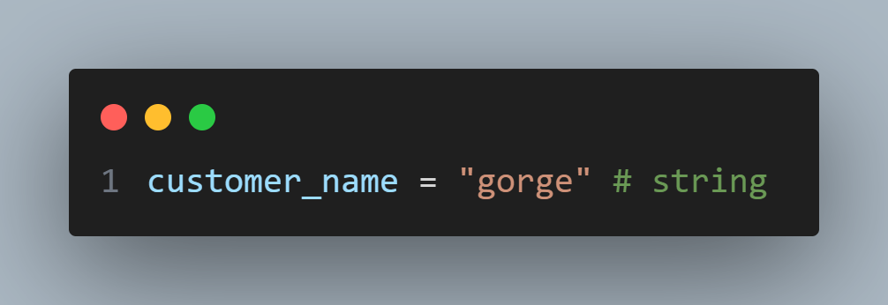
8. Strings
A string is a sequence of characters.

Slide 53
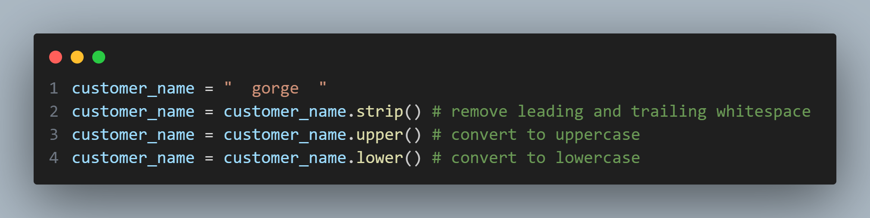
8. Strings
Common string methods
str.strip()
str.upper()
str.lower()

Slide 54
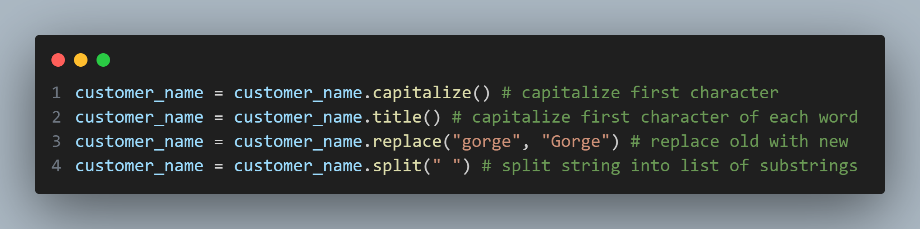
8. Strings
Common string methods
str.capitalize()
str.title()
str.replace()
str.split()

Slide 55
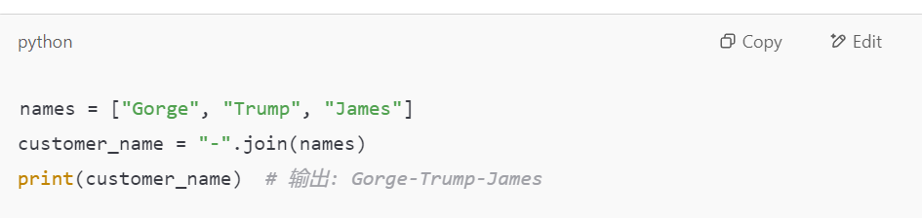
8. Strings
Common string methods
“connector”.join(list):It takes each element in the list of strings and joins them into a new single string, using "connector" as the separator

Slide 56
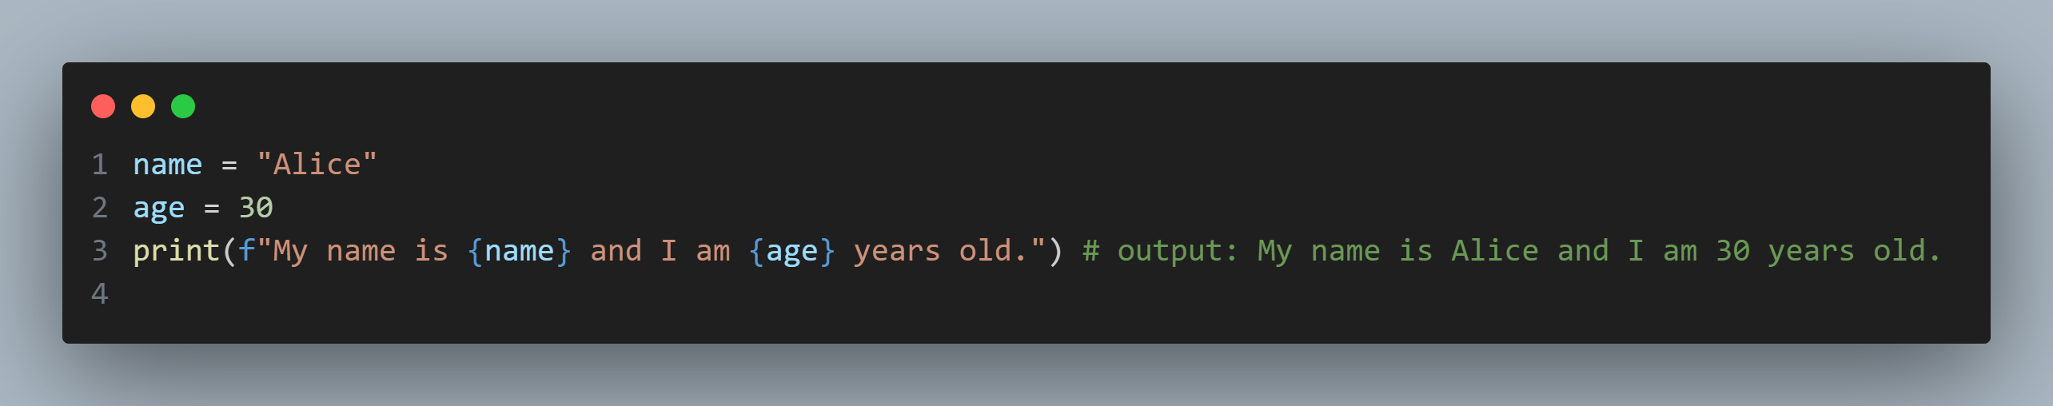
8. Strings
String formatting:f-Strings (Formatted String Literals)

Slide 57
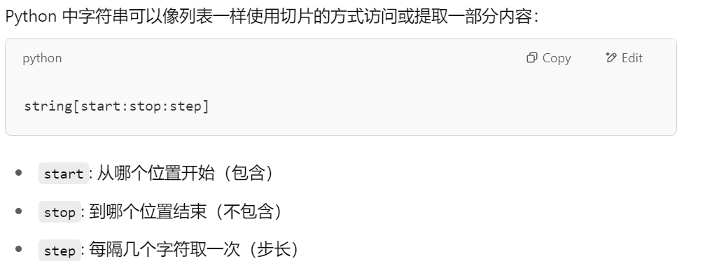
8. Strings
String Slicing
String slicing is the process of extracting a substring from a string

Slide 58
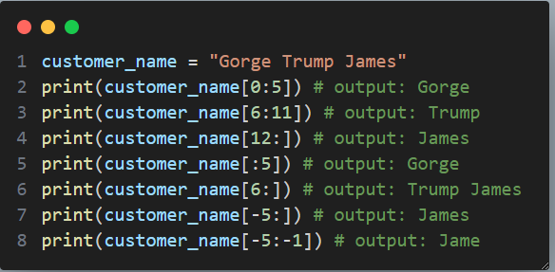
8. Strings
String Slicing
String slicing is the process of extracting a substring from a string

Slide 59
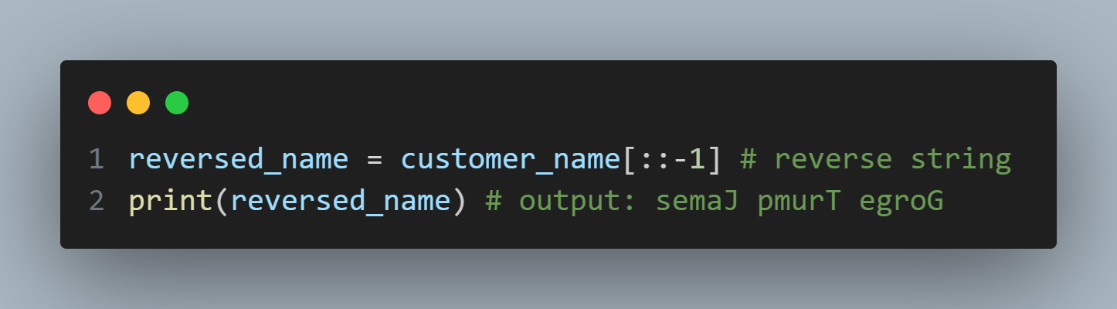
8. Strings
String Slicing-reverse string

Slide 60
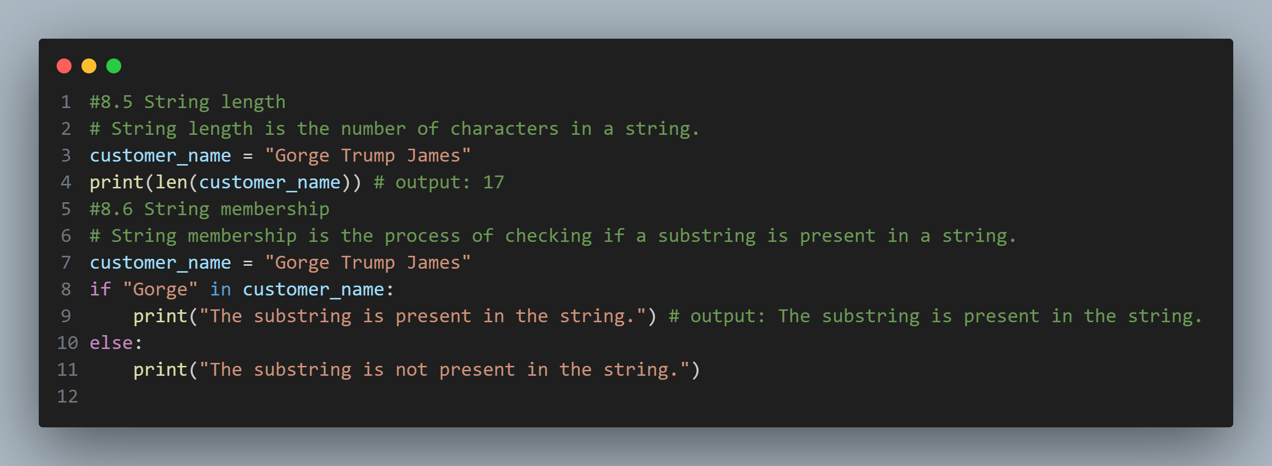
8. Strings
String length
String membership check

Slide 61
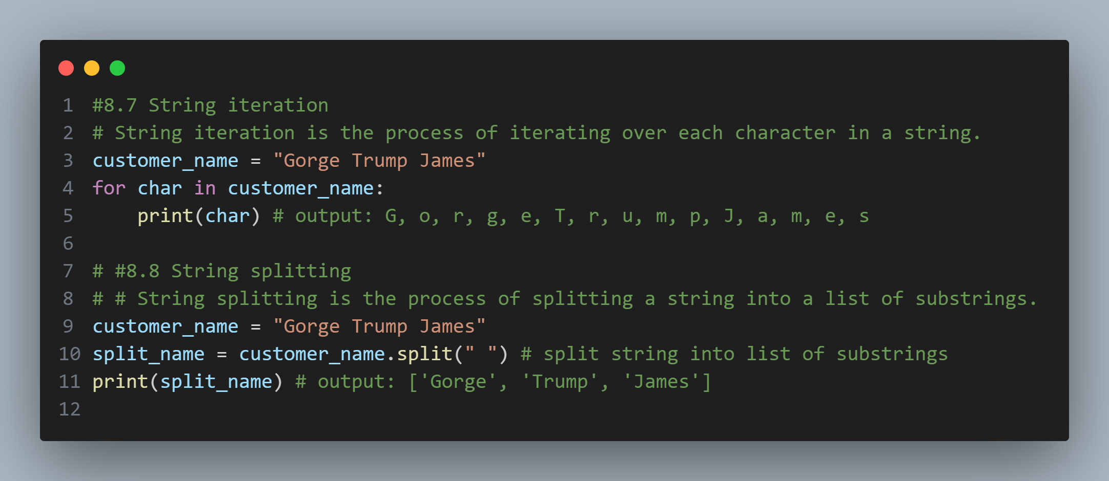
8. Strings
String iteration
String splitting

Slide 62
8. Strings
Exercise: refer to string_exercise folder

Slide 63
9. Set
A set is a collection of unique elements
Sets are unordered
Sets are mutable

Slide 64
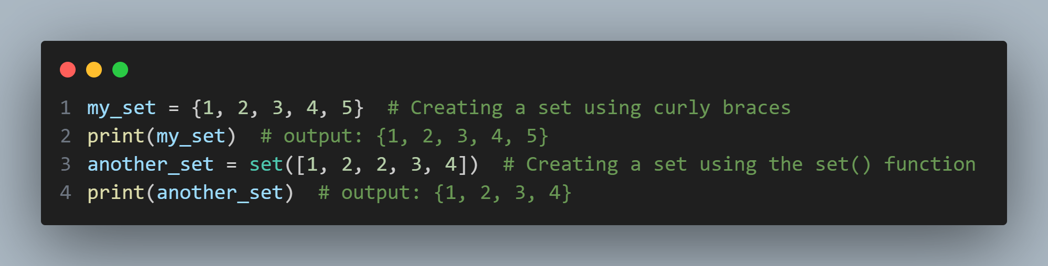
9. Set
Create a set

Slide 65
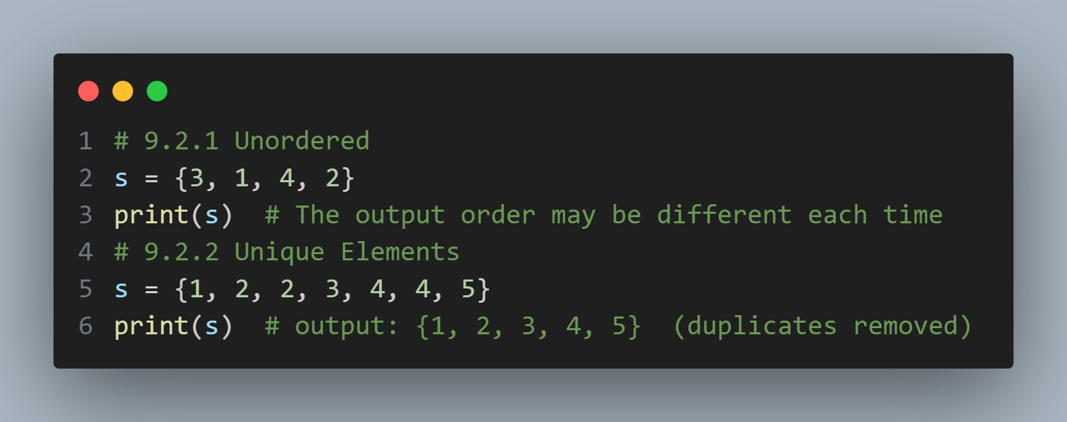
9. Set
Set Characteristics

Slide 66
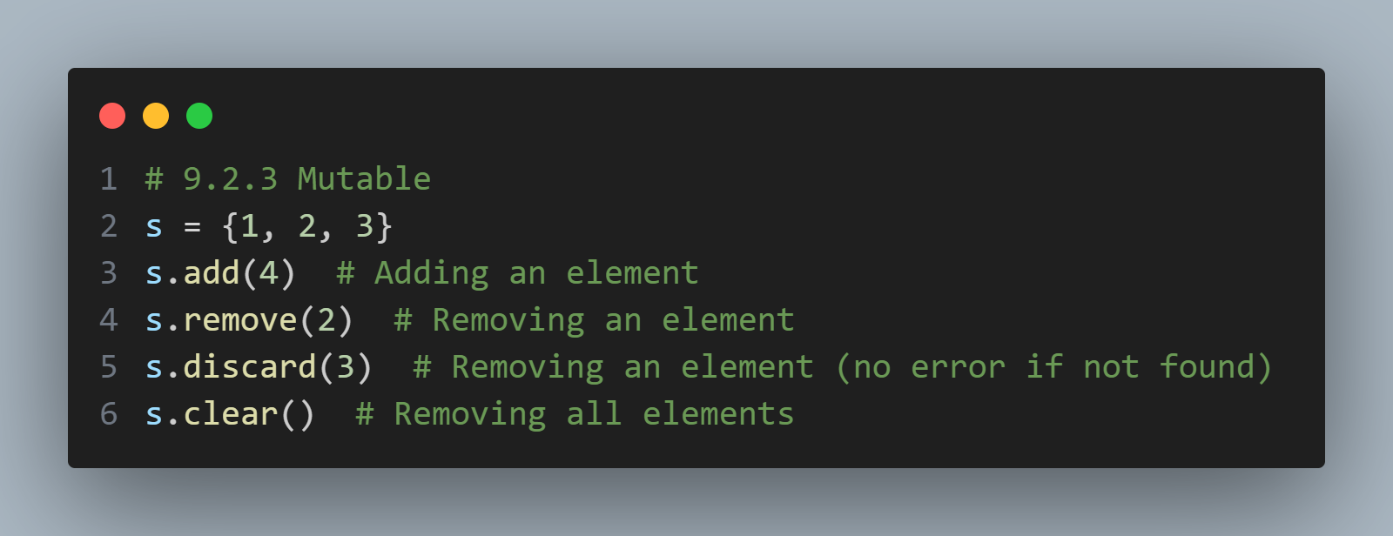
9. Set
Set Characteristics

Slide 67
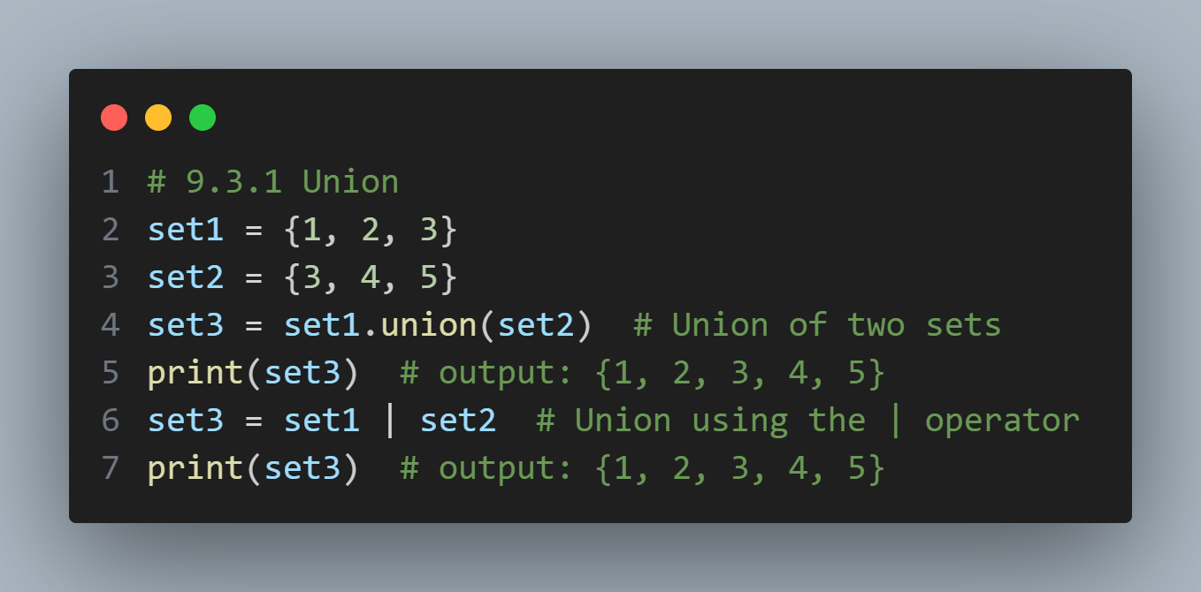
9. Set
Set Operations

Slide 68

9. Set
Set Operations

Slide 69

9. Set
Set Operations

Slide 70

9. Set
Set Operations

Slide 71

9. Set
Iterating through a set

Slide 72
9. Set
Exercise: refer to bottom of chapter9_work_with_collections_Set.py

Slide 73
10. Functions and Modules
Function
A function is a block of reusable code that performs a specific task.
Benefits:
Reuse code
Improve readability
Easier testing and debugging

Slide 74

10. Functions and Modules
Define a function
1. Start with def key word
2 followed by the custom name
3.followed by brackets and parameters(optional)
4.finally add return statement if need to return something(optional)

Slide 75

10. Functions and Modules
How to call a function
Use the function name followed by parentheses
pass arguments(data) to function if they accept any paramters
assign function returns value to a variable if function has return value

Slide 76

10. Functions and Modules
Function Parameters
Positional paramters:passed to a function in the order they are defined

Slide 77

10. Functions and Modules
Function Parameters
Default Parameters:have a default value and use this default value if no arugments passed for them

Slide 78

10. Functions and Modules
Function Parameters
Keyword arguments:Keyword arguments are the parameters that are passed to a function using the parameter name. It allows you to pass arguments in any order

Slide 79

10. Functions and Modules

Slide 80

10. Functions and Modules

Slide 81

10. Functions and Modules
Function can return 0, 1, 2 multiple values

Slide 82
10. Functions and Modules
Function Scope
The scope of a variable is the part of the program where the variable is accessible

Slide 83

10. Functions and Modules
Function Scope
Local Scope:refers to variables that are defined inside a function and only exist during that function's execution.They are not accessible outside the function.

Slide 84

10. Functions and Modules
Function Scope
Local Scope:refers to variables that are defined inside a function and only exist during that function's execution.They are not accessible outside the function.

Slide 85

10. Functions and Modules
Function Scope
Global Scope: Global scope refers to variables that are defined outside any function and are accessible throughout the entire file — including inside functions (read-only by default)

Slide 86
10. Functions and Modules
Modules
A module is simply a Python file (.py) that contains functions, classes, or variables that you can import and reuse in other files

Slide 87

10. Functions and Modules
Modules
Built-in modules

Slide 88

10. Functions and Modules
Modules
Custom modules

Slide 89

10. Functions and Modules
Modules
if __name__ == "__main__":It’s a common Python idiom that controls whether a script runs standalone or is imported as a module.

Slide 90
10. Functions and Modules
Exercises
1. convert the code in count_occurrences.py in list_exercise folder into function and run function verify the result
2. convert the code in find_maximum.py into function in list_exercise folder and run function verify the result
3. create a function called get_product_discount that takes product_name as parameter and its default_value = “apple”. It returns a number depends on the value of product_name. If product_name is apple, returns 0.9, if product_name is “orange” return 0.8, everything else return 0.5

Slide 91

11. Error handling

Slide 92

11. Error handling

Slide 93

11. Error handling

Slide 94

11. Error handling

Slide 95
12. Pandas
Pandas is a Python library for data analysis and manipulation, widely used in finance for:
Time-series analysis (e.g., stock prices, trading volume)
Data cleaning & transformation (e.g., handling missing data, reformatting)
Performance metrics & statistics (e.g., calculating returns, PnL)

Slide 96

12.1 Pandas basics
Series and DataFrame

Slide 97

12.1 Pandas basics

Slide 98

12.1 Pandas basics
Index

Slide 99

12.1 Pandas basics
Common index operation

Slide 100

12.1 Pandas basics
Select columns
Filter rows
Sort value

Slide 101

12.1 Pandas basics
Group by and aggregate

Slide 102

12.1 Pandas basics
Read data from csv and save data to csv

Slide 103

12.2 Pandas cleaning and transform data
dropna function
fillna function

Slide 104

12.2 Pandas cleaning and transform data
filter data with multiple filtering condition
speparate multiple conditions with () and combine them using &

Slide 105

12.2 Pandas cleaning and transform data
Convert data types in pandas
How to check existing columns’ data types:df.dtypes

Slide 106
12.2 Pandas cleaning and transform data
Convert data types in pandas
Object in pandas is like a box that can hold anything.
Most of the time, it means the column has text (strings), but it could also hold other Python types

Slide 107

12.2 Pandas cleaning and transform data
Convert data types in pandas

Slide 108

12.2 Pandas cleaning and transform data
Convert data types in pandas
Common Type Conversions: To String

Slide 109
12.2 Pandas cleaning and transform data
Convert data types in pandas
Common Type Conversions: To String

Slide 110

12.2 Pandas cleaning and transform data
Convert data types in pandas
Common Type Conversions: To Integer

Slide 111

12.2 Pandas cleaning and transform data
Convert data types in pandas
Common Type Conversions: To Datetime

Slide 112
12.2 Pandas cleaning and transform data
Convert data types in pandas
Common Type Conversions: To Datetime

Slide 113

12.2 Pandas cleaning and transform data
Convert data types
Convert numeric column with dirty data

Slide 114

12.3 Pandas data manipulation
Merge dataframe:combine two data frame into one

Slide 115

12.3 Pandas data manipulation
Merge dataframe:combine two data frame into one

Slide 116

12.3 Pandas data manipulation
Merge dataframe: Inner Join

Slide 117


12.3 Pandas data manipulation
Merge dataframe: Left Join

Slide 118

12.3 Pandas data manipulation
Merge dataframe: Inner Join with different columns

Slide 119
12.3 Pandas data manipulation
Add new column based on conditions: numpy.where

Slide 120

12.4 Pandas apply and aggregation
Apply function

Slide 121

12.4 Pandas apply and aggregation
Apply function
apply function to a series (column)

Slide 122

12.4 Pandas apply and aggregation
Apply function
apply function to a dataframe

Slide 123

12.4 Pandas apply and aggregation
Apply function
apply function to a dataframe:row-wise(axis=1)

Slide 124

12.4 Pandas apply and aggregation
Apply function
apply function to a dataframe:column-wise(axis=0)

Slide 125

12.4 Pandas apply and aggregation
Aggregation

Slide 126

12.4 Pandas apply and aggregation
Aggregation

Slide 127

12.4 Pandas apply and aggregation
Aggregation
aggregate a single column

Slide 128

12.4 Pandas apply and aggregation
Aggregation
aggregate a single column

Slide 129

12.4 Pandas apply and aggregation
Aggregation
aggregate on multiple columns

Slide 130

12.4 Pandas apply and aggregation
Aggregation
aggregate on multiple columns

Slide 131

12.4 Pandas apply and aggregation
Aggregation
aggregate on multiple columns:make results format better with reset_index and columns

Slide 132

12.4 Pandas apply and aggregation
Aggregation
aggregate on multiple columns:make results format better with reset_index and columns

Slide 133

12.4 Pandas apply and aggregation
Aggregation
aggregate on multiple columns with multiple aggregation functions

Slide 134

12.4 Pandas apply and aggregation
Aggregation
aggregate on multiple columns with multiple aggregation functions

